Slide 1
Mississippi Medical
Marijuana Association

Slide 2

agenda
The Business Impact of Failing Testing
Who is Ziel?
Why Radio Frequency (RF)?
Ziel’s RFX Solution for Cannabis
How We Compare
Financing
The Process Forward

Slide 3

Failing is expensive…
Operational Interruption
Retesting
Lost Time to Shelf
Product Recall
Reputational Damage
Forced Discounting
  Dispensaries – Remediation in METRC
  Manufacturers – Pricing Parity with Biomass

Slide 4
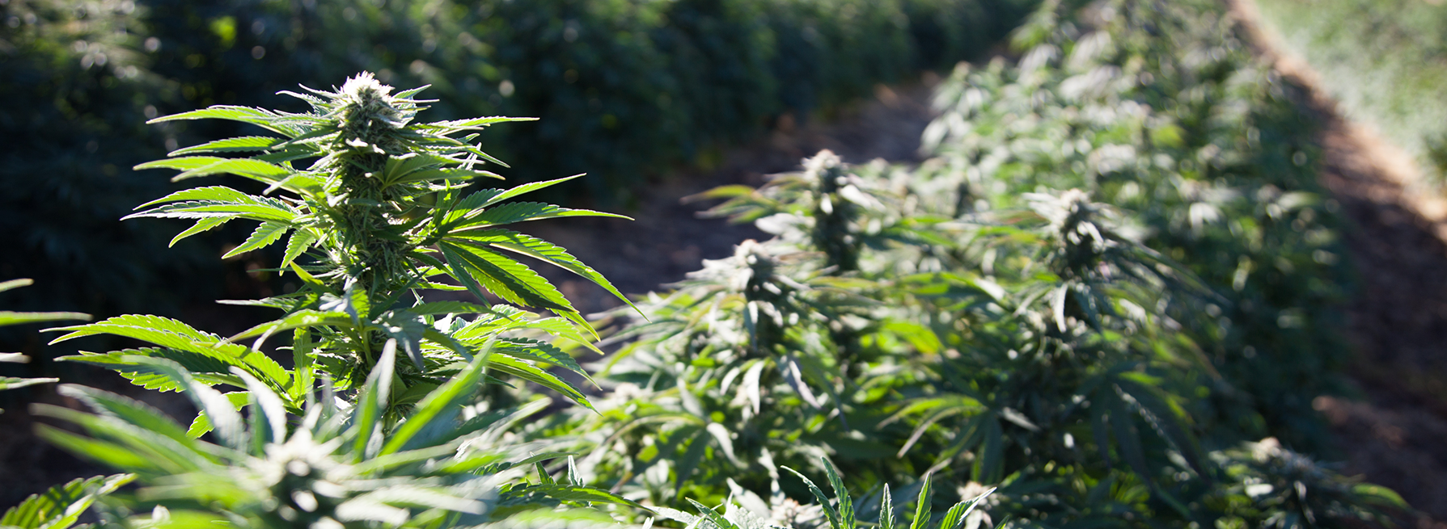
ADDING A Microbial control solution recovers lost revenue
CASE STUDY | MISSISSIPPI OPERATOR
Dried Flower | $1,100 lb | Dried Flower Harvest | 5,000 lb
Biomass / Trim | $100 lb | Microbial Failure | 20%
MARGINAL REVENUE / LB | $1,000 LB | REVENUE RECOVERED | $1,000,000

Slide 5
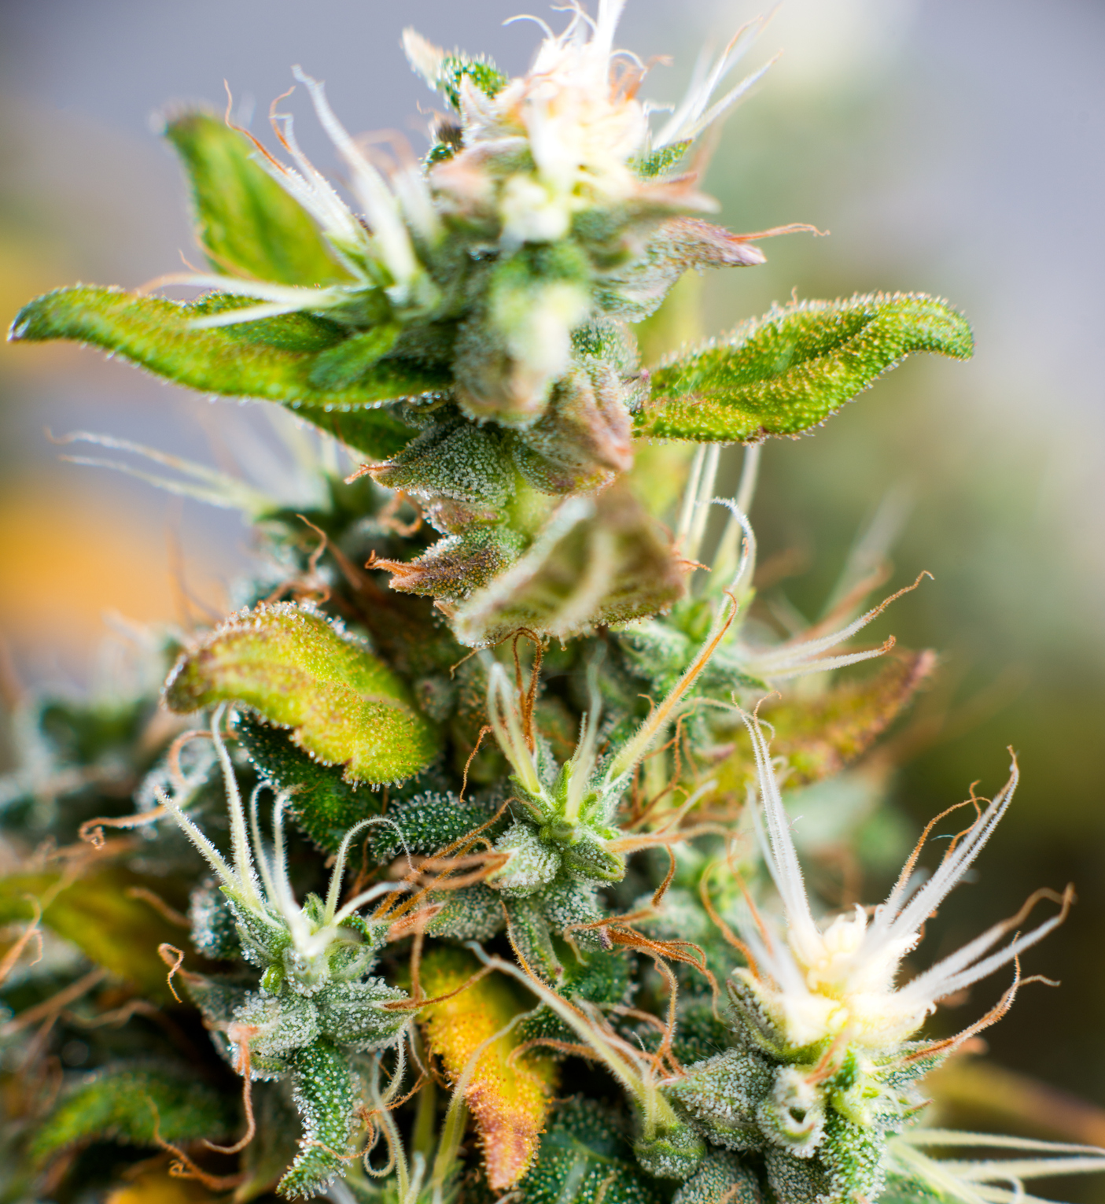



ZIEL
Subject Matter Experts on Radio Frequency
Commercialized RF for Food Pasteurization
Introduced RF to Agriculture 2010
Then Applied to Cannabis in 2015
Customers Throughout US and Internationally
Notes:
Collaboration with University of California, Davis
Nuts, Seeds, Dates, and Prunes

Slide 6
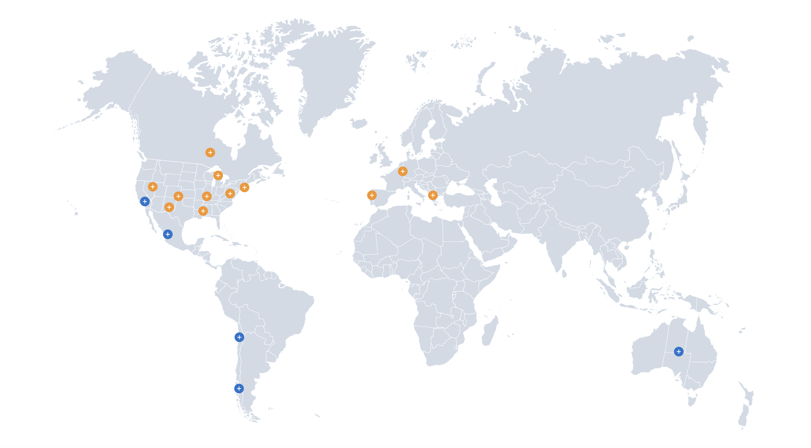


A GLOBAL REACH
Our worldwide footprint spans 4 continents, covering growers and processors in nuts, seeds, dates, prunes, and cannabis.
Cannabis Operators
Agricultural Processors
Manufacturing
R&D
+
+

Slide 7
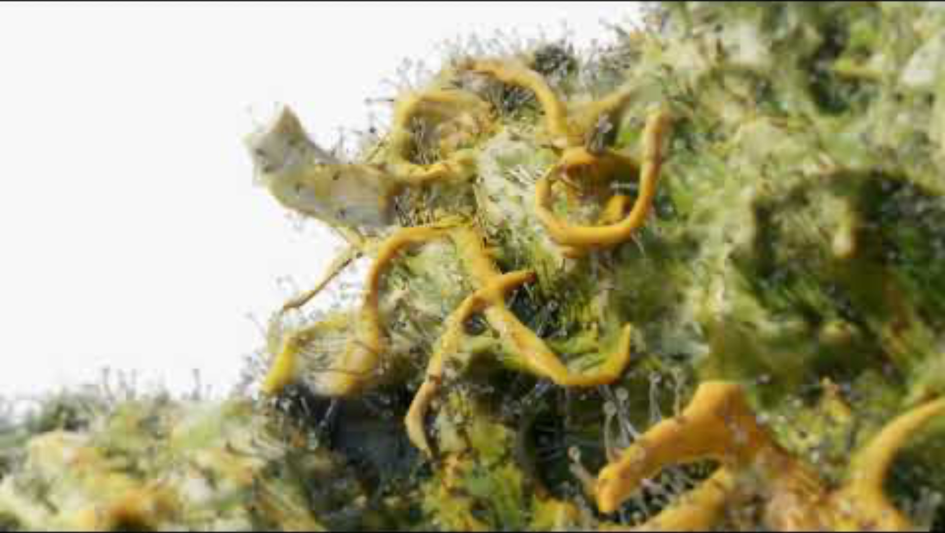
WHY Radio frequency technology?
Effective for Microbial Pathogen Reduction
Commercially Proven
Thermal Process
Targeted and Evenly Distributed
Non-Ionizing Radiation
Organic Process Compliant (USDA)
No Mandatory Labeling (FDA)
EU GMP Approved (EudraGMDP)

Slide 8
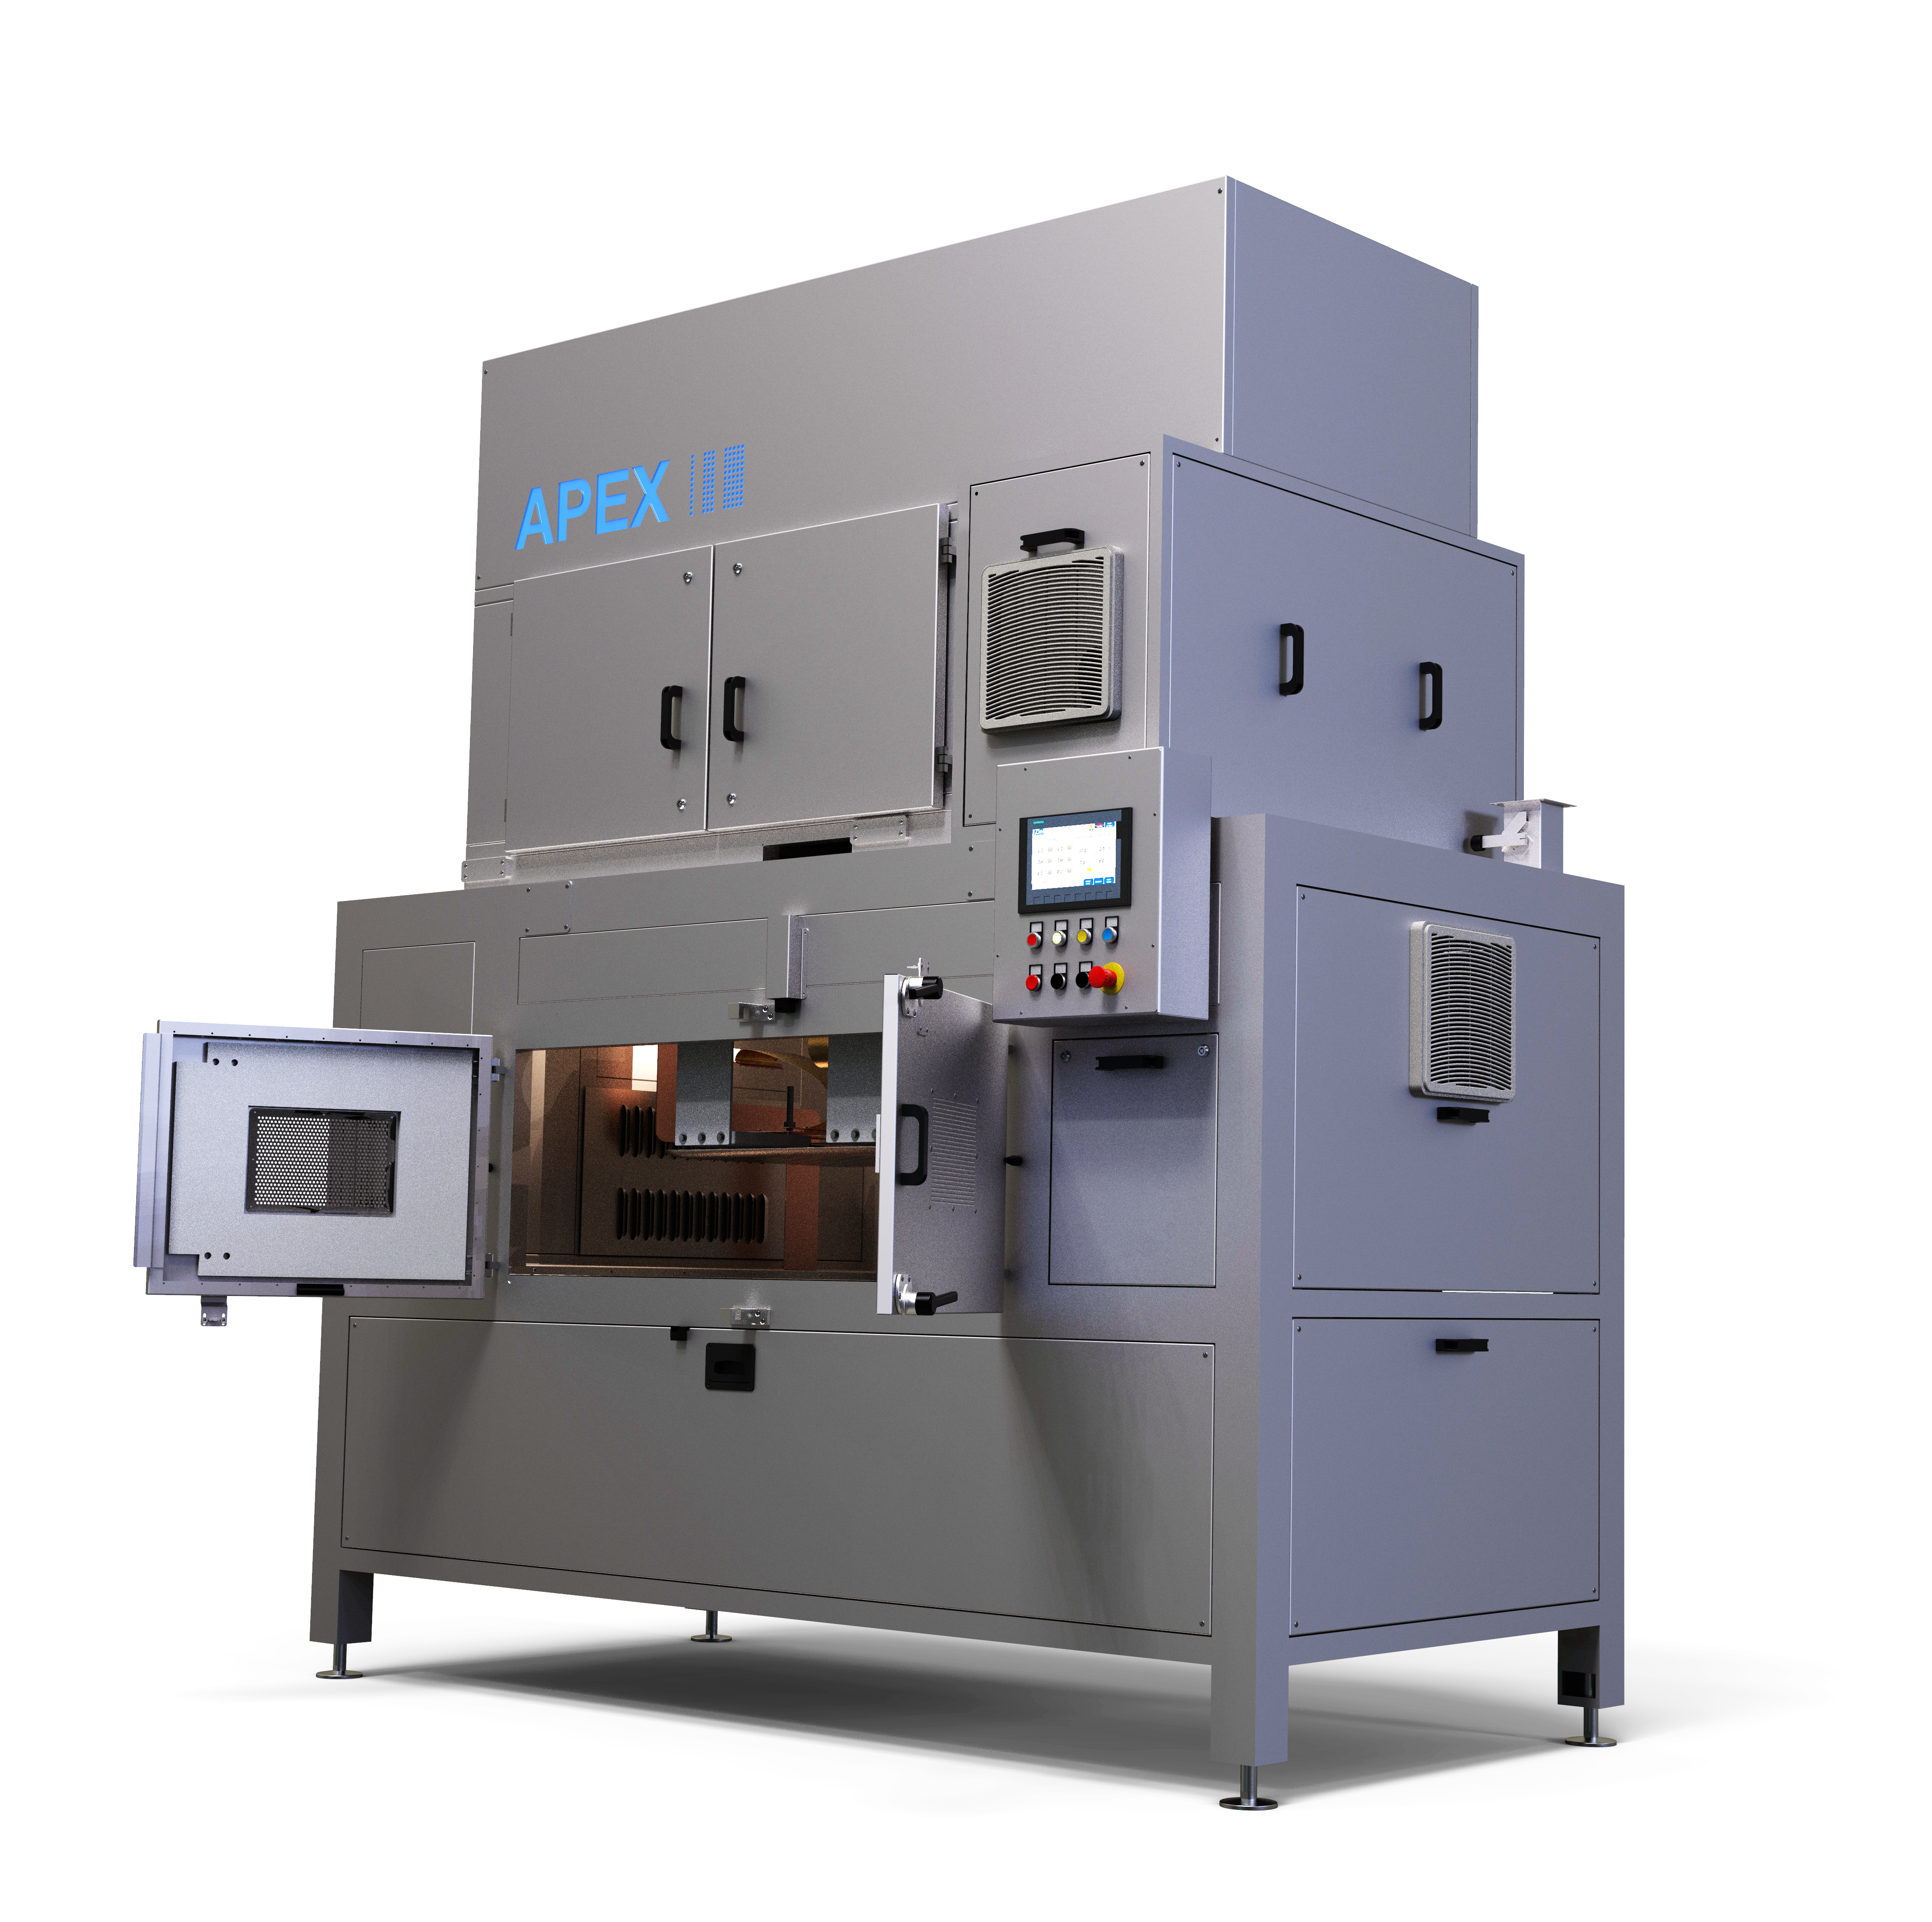
5 YEARS COMMERCIAL USE | 2017-2022
Oversized Power & Footprint
480 VAC 3-Phase Power
90 dB Noise Level
3-Day Install
Basic HMI User Interface
Basic Aesthetics
More than 40 installations

Slide 9
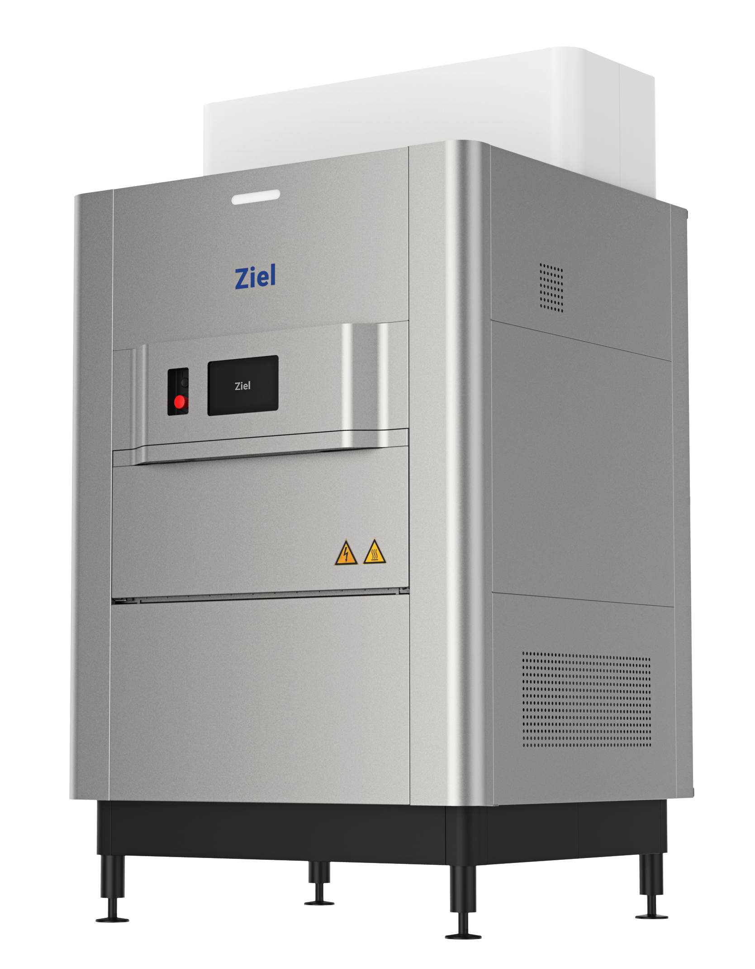
ZIEL RFX
Microbial Control Solution
What Are Your X Factors?
Predictable | > 99% Pass Rate Preserves Bag Appeal
Efficient | Highest Industry Throughput Lowest Processing Cost
Dependable | 24/7 Equipment Uptime Solid State Electronics
Safe | No X-Ray, Gas, or Chemicals Organic Process Compliant

Slide 10
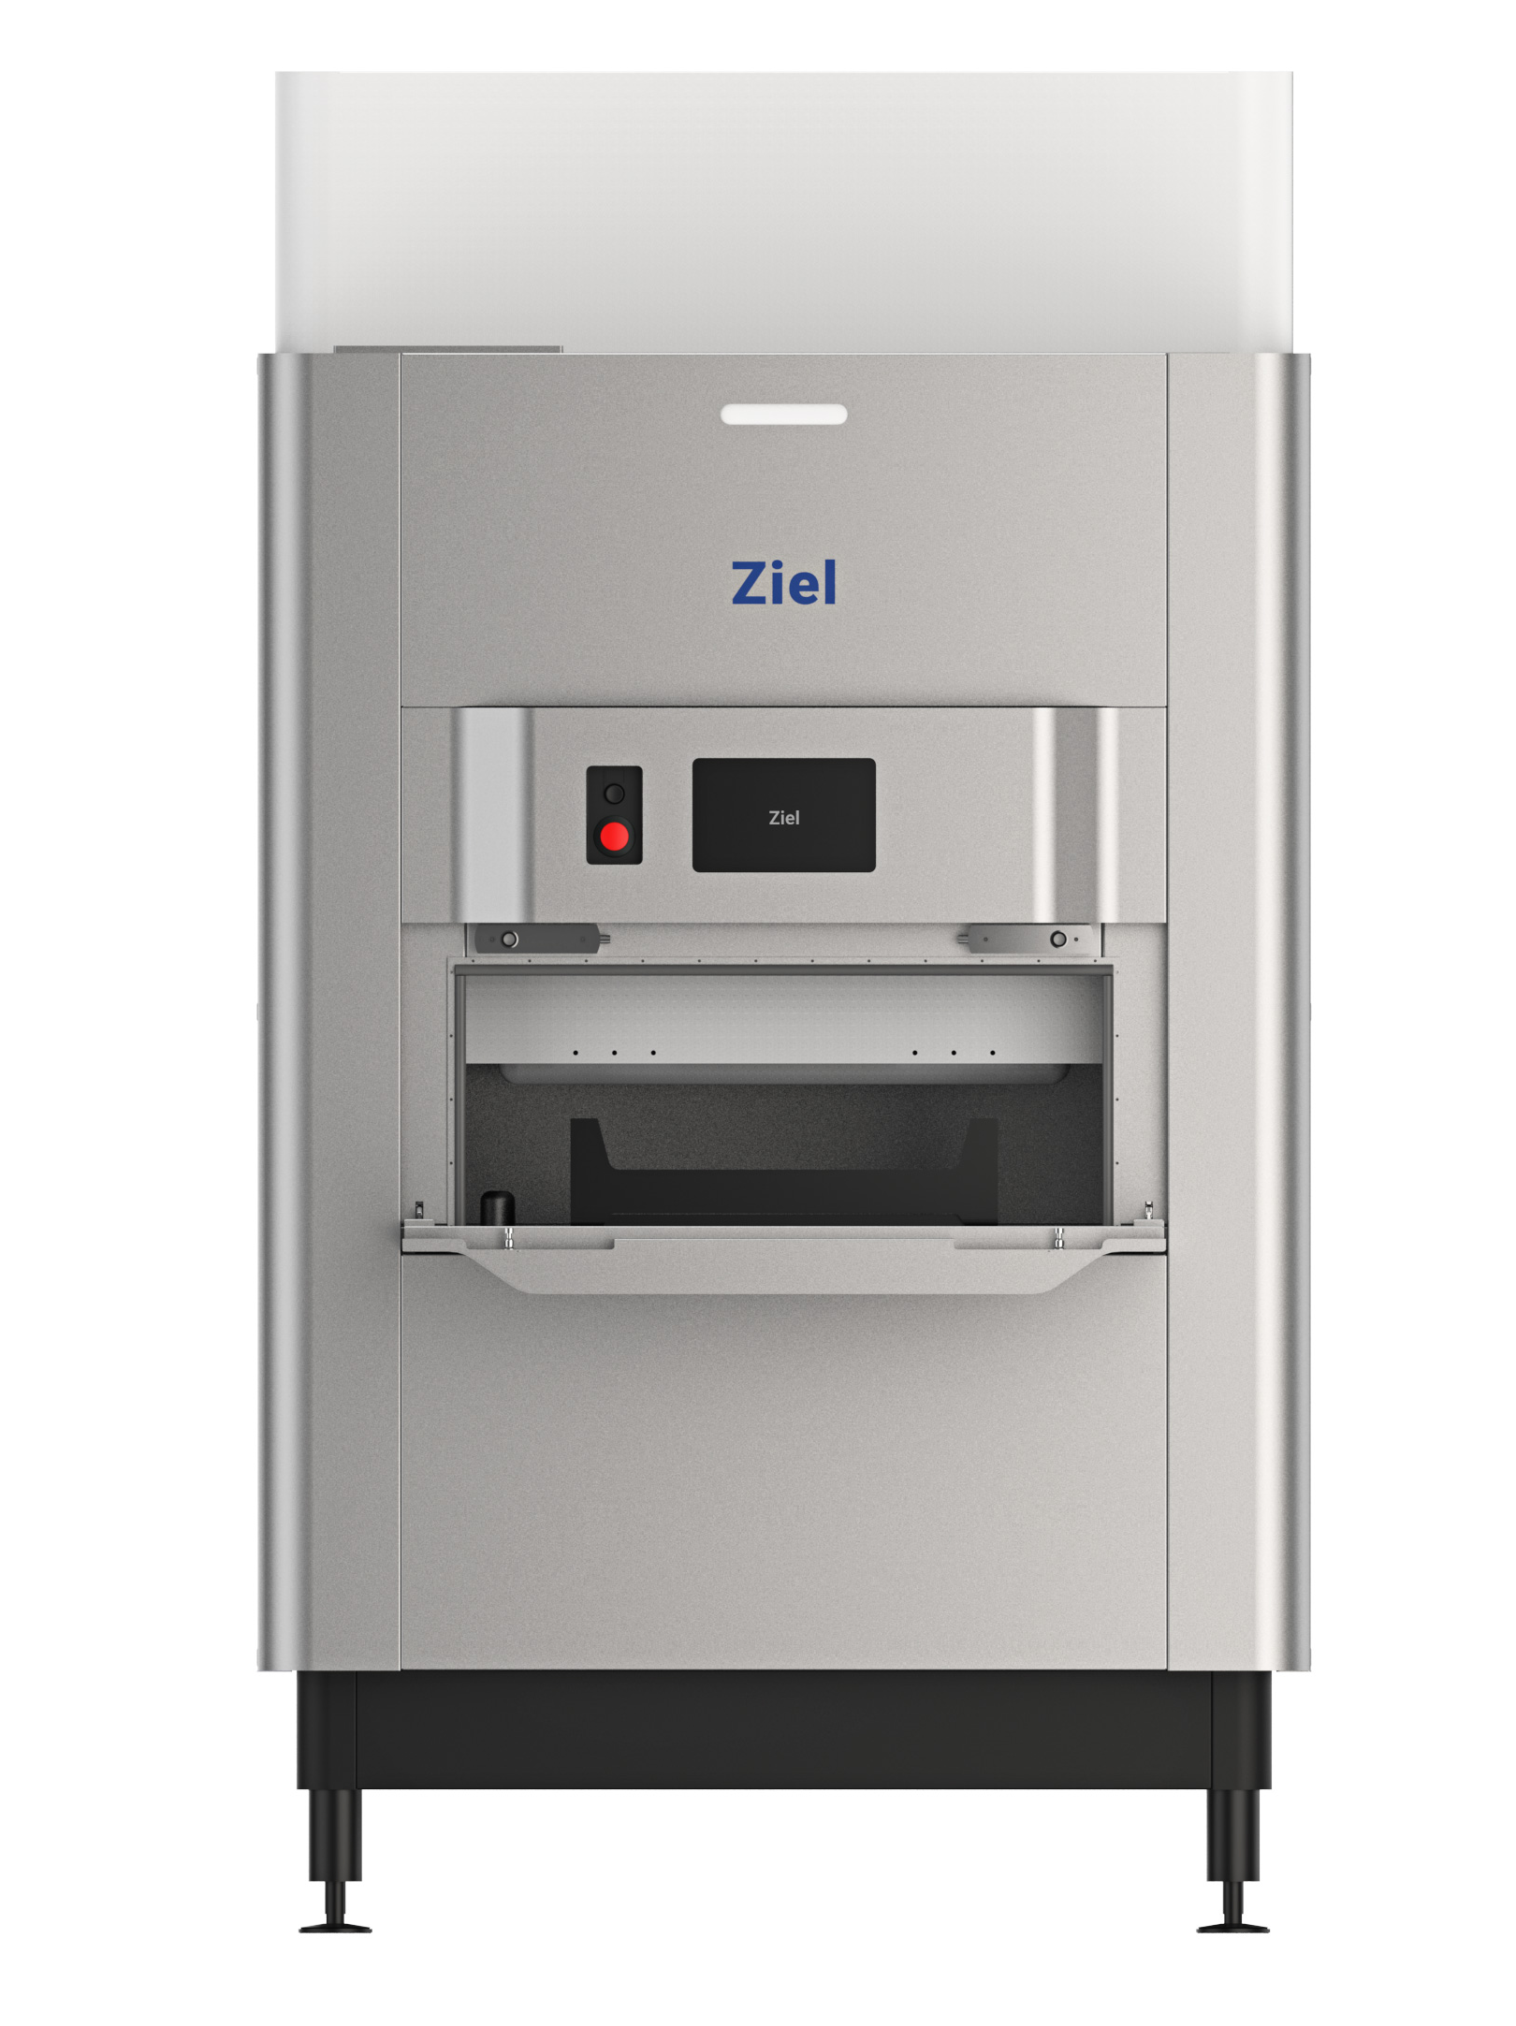
Addresses all your stakeholder needs
Operations | 5 lb / 2.3 kg per cycle 14-minute average cycle time Single phase 240 VAC 1 Day Installation
Financial | Less than $3 processing cost per lb Leasing and Financing Options
Quality | Up to 3 log microbial pathogen reduction Penetrates throughout the flower Retains plant’s natural enzymatic properties

Slide 11
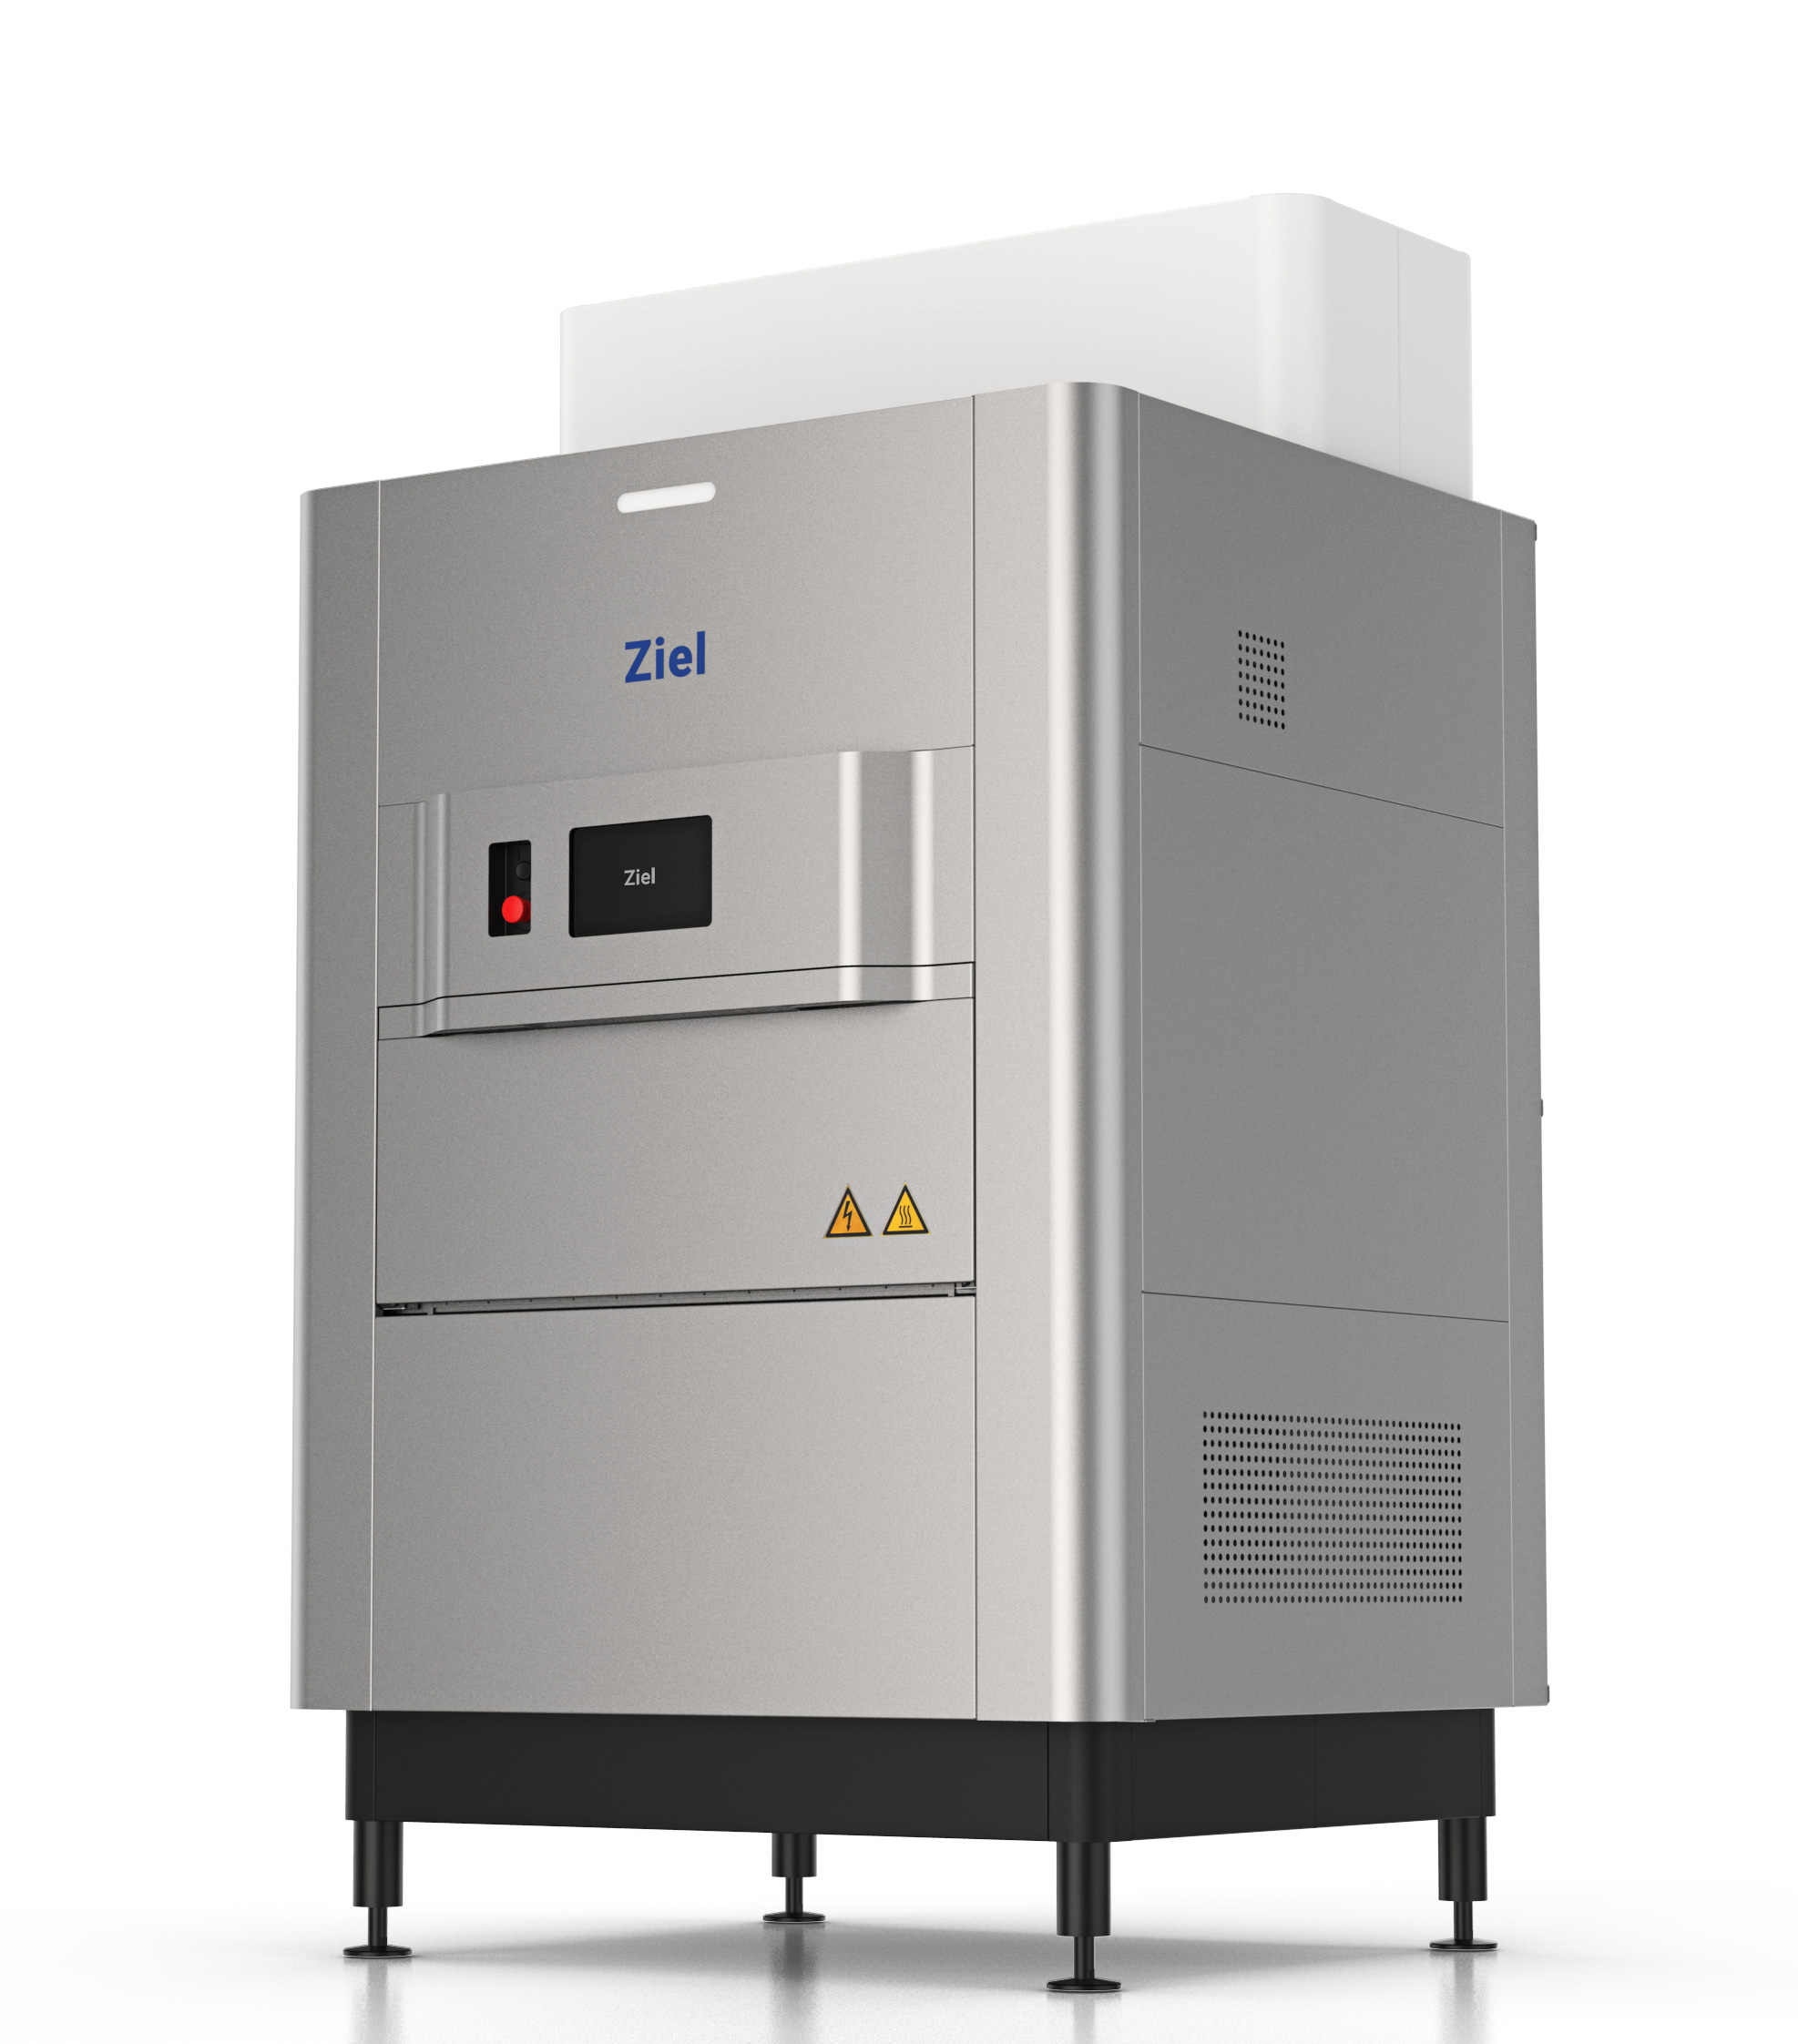
features & benefits
 | APEX 7 | RFX
Footprint | 42 ft² | 20 ft²
Capacity | 480 lb / 12 hours | 480 lb / 12 hours
Power | 480 VAC Three-Phase | 240 VAC Single-Phase
Noise | 90 dB | <70 dB
Installation | 3-Days | Plug & Play
Turn-Key Price | $240,000 | $340,000

Slide 12
How we compare with the competition
 |  | Radio Frequency | X-Ray | Ozone | Reactive Oxygen | Gamma / E-Beam
Operations | Throughput / 24 hr | 480 lb | 90 lb | 50 lb | 240 lb | N/A
 | Facility Upgrade | $0 | $20,000 | $0 | $0 | N/A
Operations | Warranty (after year 1) | $24,000 | $35,000 | N/A | Unknown | N/A
Financial | Unit Cost | $340,000 | $340,000 | $140,000 | $140,000 | Toll Model
Finance | Consumables | Yes | Yes | No | Yes | N/A
 | Processing $ / lb* | $2.88 | $10.43 | $4.22 | $26.52 | $27.00
Quality | Efficacy | >99% | >99% | >95% | >95% | >99%
Quality | Labeling Impact | Thermal | Ionizing Radiation | Gas | Chemical | Ionizing Radiation
 | Organic | ✔︎ | x | ✔︎ | x | x

Slide 13
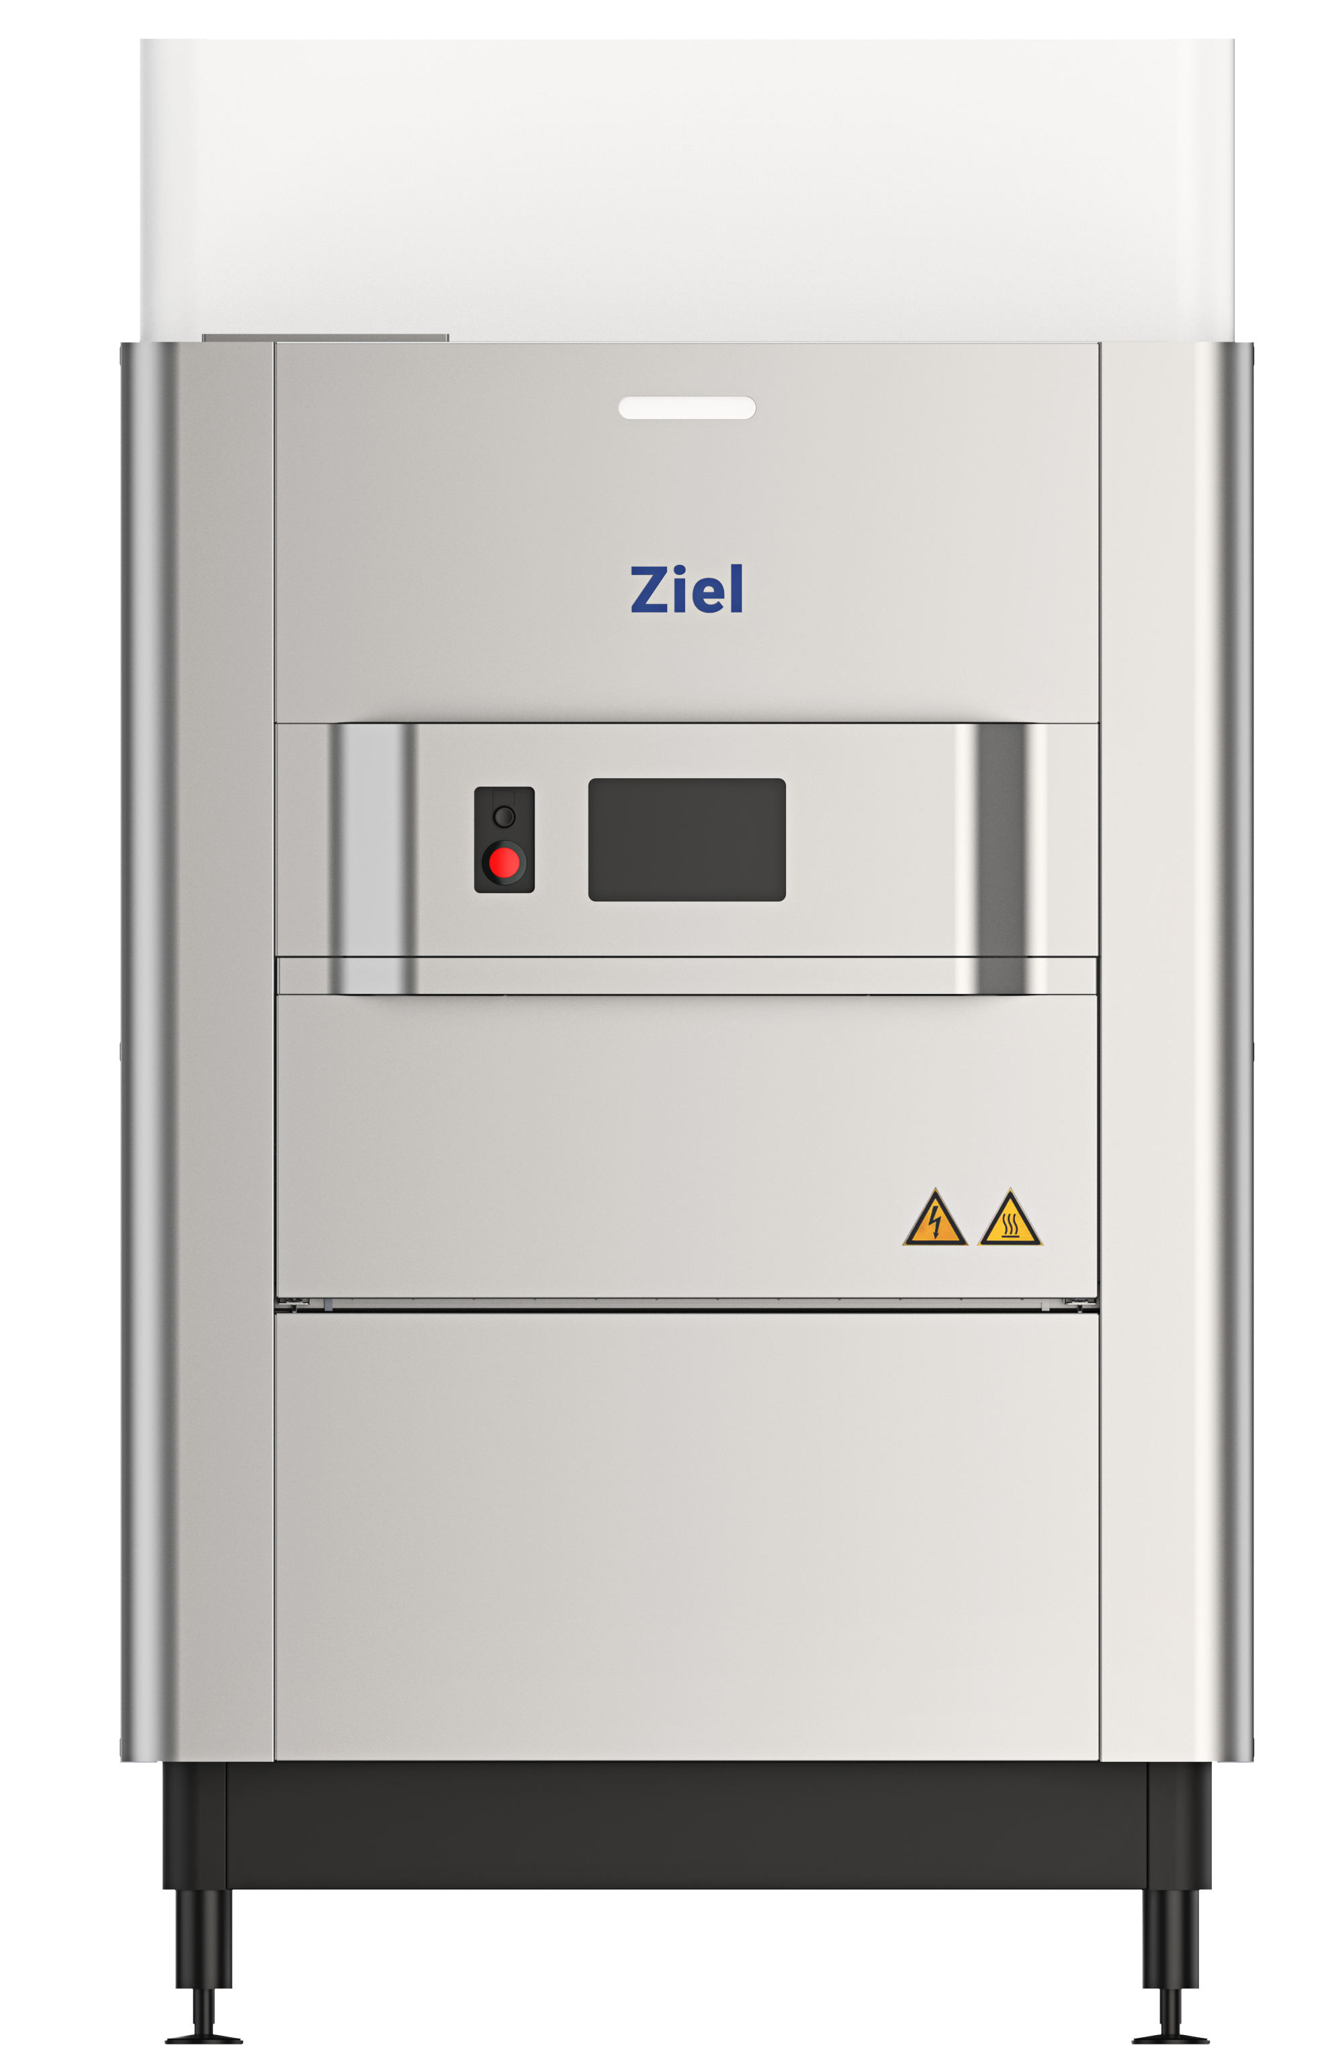
A single RFX does the work of 5 RAD units…at 1/5 the cost
=
+
+
+
+
90 lb / 24 hr
$360,000
90 lb / 24 hr
$360,000
90 lb / 24 hr
$360,000
90 lb / 24 hr
$360,000
90 lb / 24 hr
$360,000
1 Ziel RFX UNIT
480 lb / 24 hr
$340,000
5 RAD 420 UNITS
450 lb / 24 hr
$1,700,000

Slide 14
A Range of models – all at a turnkey price
RFX
APEX 7
APEX 7
Reconditioned
$340,000
$304,000
$240,000
Inventory USA*
Inventory USA*
Inventory USA*
240 VAC
480 VAC
480 VAC
20 ft²
42 ft²
42 ft²
*In Stock

Slide 15
A Range of purchase Options to Meet Your Needs
Cash Purchase
Leasing
Financing
$US $340,000
$1 Buyout at Term
Own an RFX on Day 1
90% Ready to Ship
10% Upon Installation
2-5 Year Terms
Finance application
Monthly Payment
Monthly Payment
Ziel Finance Partners
Ziel Finance Partners

Slide 16
Our process
NDA, COAs & Business Case
  Ziel reviews COAs; prepares business case
Execute Binding Term Sheet
  Customer unit reserved; speak with or visit Ziel customers
Execute Agreement
  Cash purchase or apply for financing through Ziel partners
Pre-Installation Meeting
  Onboarding with Facility, Operations and QA stakeholders
Installation
  Ziel field service technician on site: 1 day
Commissioning
  Commissioning begins Immediately after installation: 2 days

Slide 17
THANK YOU
Arthur de Cordova
CEO & Co-Founder
arthur.decordova@ziel.com
+1 415 531 4084

Slide 18
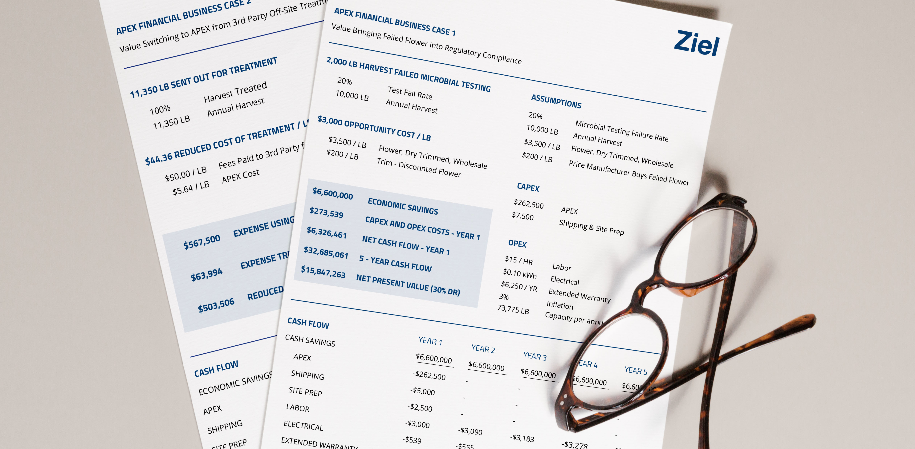
YOUR BUSINESS CASE
My Business | My Market
Annual Volume
Fail Rate
Wholesale
Biomass
My Economic Benefit
Recovered Revenue
Increase in Yield
Opportunity Cost per lb
Sample Leasing Option
Recovered Revenue
# Year Lease
# Deposit
1st Month Out of Pocket

Slide 19

STALAM & ZIEL GLOBAL PARTNERSHIP
Largest Radio Frequency Manufacturer Worldwide
2,600 Machines Deployed in 70 Countries
Established 1978 – Based in Nove, Italy
Privately Held
Ziel’s Manufacturing & Engineering Partner
RFX built exclusively for Ziel
Designed for Cannabis by Ziel
Global Service & Support
Ziel Proprietary Software & Patents

