Slide 1

CANNABIS DECONTAMINATION SYSTEM www.xrpure.com

Slide 2
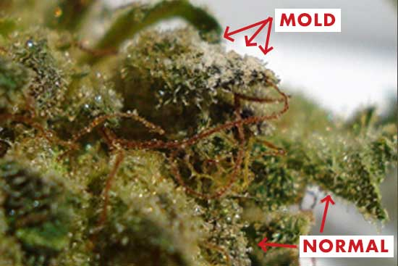
Microbial Decontamination for Cannabis Flower
Controlling microbial growth can be difficult
Remediation methods used in food and other industries are not always appropriate for treating cannabis.
Each batch must be tested and meet state mandated limits for microbials and other substances.
MS Microbial Test Limits for Flower, Sec 5.4.2
Total Yeast and Mold (TYMC) <= 10,000 cfu/g
Total Coliform < 100 cfu/g (e.g. Nevada 1000 cfu/g)
Absence of Aspergillus, E.coli, and Salmonella in 1g
XRpure has resources to help
https://xrpure.com/blog/

Slide 3
agenda
Benefits of X-ray Decontamination
How Does It Work?
Is My Weed Radioactive?
Dosing Guidelines & Recommended SOP
X-ray Registration in Mississippi
XRpure Technology
MS Remediation Service

Slide 4
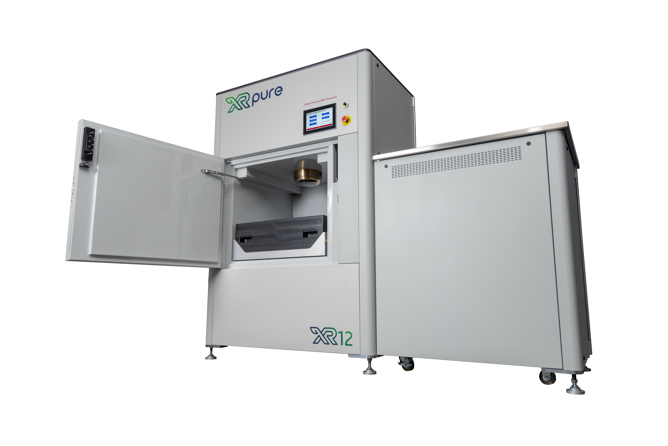
decontamination Using X-ray Energy
Benefits of X-ray Irradiation
  Full penetration – unlike a surface treatment
  Can treat final product, pre-rolls, trim, …
  Controllable / tunable to your strains / product
  In-factory solution
  Minimal effect on the plant
  No chemicals or residues
  No motion or tumbling
  No heating or premature decarboxylation
  Extends shelf life of cannabis
XRpure Capacity
  Approximately 2.5 hrs to process 15-20 lbs (2 kGy)
  130+ lbs per day if operated 24 hrs / day

Slide 5

How Does X-Ray Sterilization Work?
X- Ray =
Notes:
And if a mold spore were the size of a golf ball

Slide 6

How Does X-Ray Sterilization Work?
Mold Spore =
Notes:
And if a mold spore were the size of a golf ball

Slide 7

How Does X-Ray Sterilization Work?
Plant Cell =
Notes:
Then a plant cell would be the size of a pick up truck.

Slide 8

Notes:
Now back to our golf ball sized mold spore. If we magnify down inside the spore we begin to see the molecular structure and individual DNA strands.

Slide 9

Notes:
Because the X-rays are of similar size to chemical bonds within the microbe DNA, the X-Ray photons target simple organisms such as mold, mildew, and bacteria.

Slide 10

Notes:
When X-Ray photons hit the DNA it disrupts chemical bonds within the microbe DNA, making them inert and unable to reproduce.

Slide 11
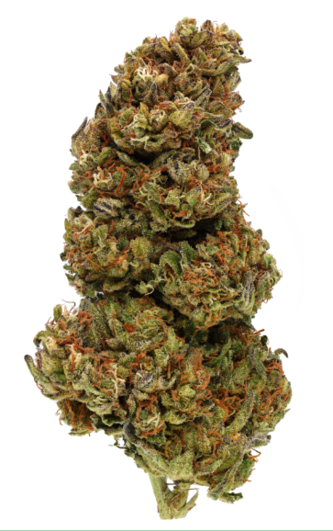
Is my weed Radioactive?
No!
  X-rays are a high frequency wave similar to visible light
  When the power is off, the X-rays are off
Premium Branding
  Vulnerable medical patients and savvy consumers and concerned about microbes and mycotoxins
  MMCB compliance is a must
  Recalls and secret shoppers are a risk
  Guarantee a clean product for your customers

Slide 12
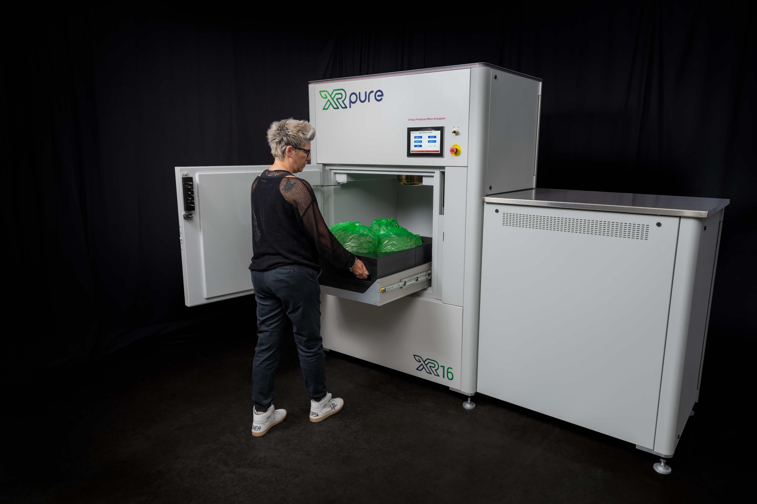
Dosing Guidelines
X-ray dose is measured in Grays (Gy)
Typical dose is 2000 Gy
Higher contamination levels may require 2500 – 3000 Gy
Process control dose may be as low as 700-800 Gy
Recommended Process for Flower
Standard process step post harvest
Dry, buck, trim, decontaminate
Send for state testing
Package & sell

Slide 13
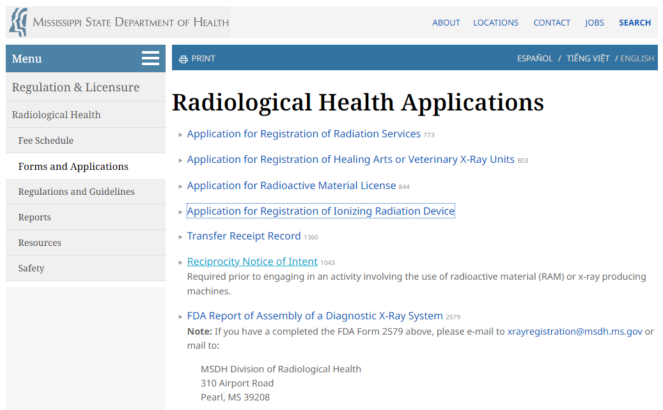
X-ray machine registration in MS
MSDH requires X-ray machine registration
https://msdh.ms.gov/page/30,0,102,1058.html
Click – Application for registration of ionizing radiation device
Registration fee is $145
Requirements
  Site and machine information
  Safety evaluation of the machine (survey)
  Personnel monitoring
  Radiation safety officer (RSO)
  X-ray safety training

Slide 14
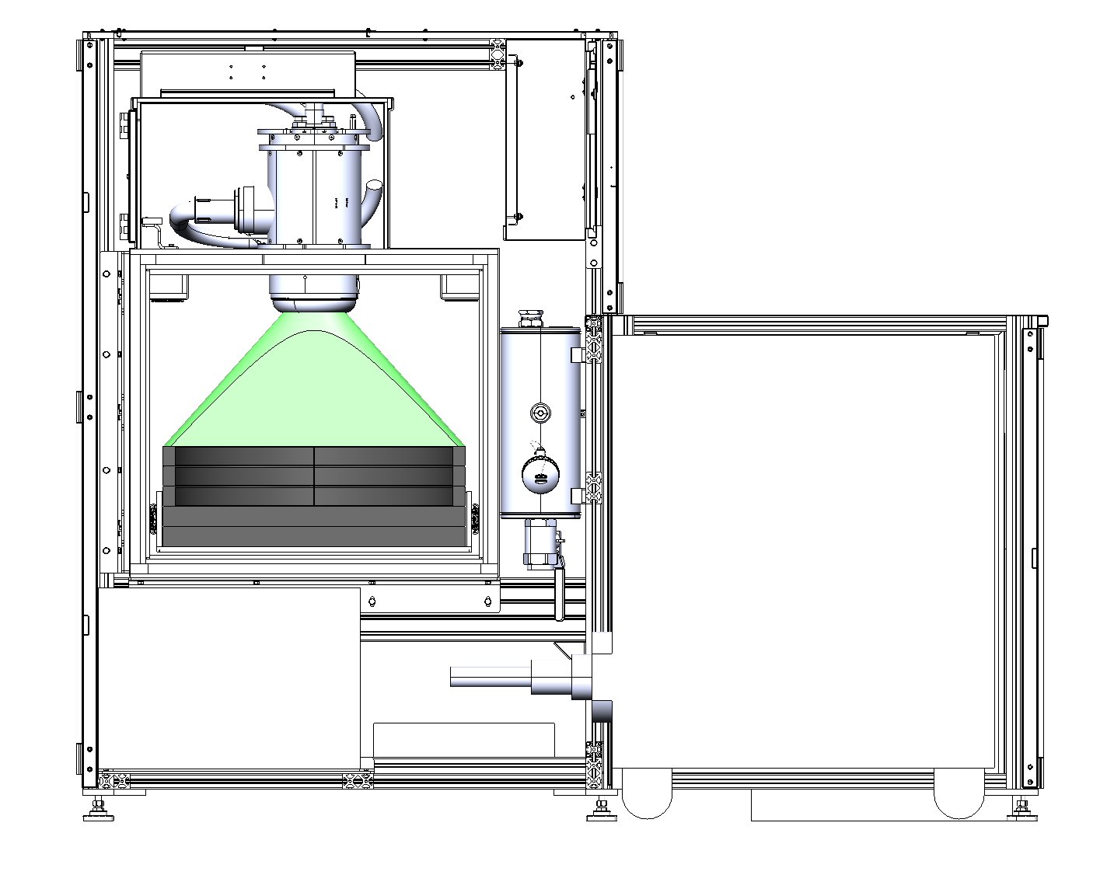
XRpure Technology
Powerful 12kW X-ray Tube
Simple Design Promotes Reliability
Safety systems meet FDA 21CFR 1020.40
Patented XReflect™ tray reflects 10-15% of x-ray energy back into product
Powerful 12kW X-ray tube delivers consistent dose faster
Simple touch-screen interface
https://xrpure.com/calculator/
Electronics / Controls
Shielded Treatment Area
Patented XReflect™ Tray
X-ray Power Supply
Heat
Exchanger

Slide 15
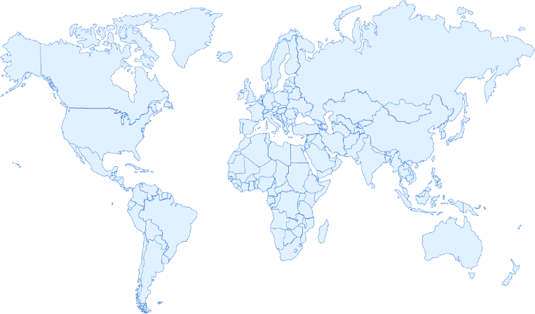

VAREX IMAGING CORPORATION
Global Facilities
Connect & Control Solutions HQ
Dinxperlo, Netherlands
Loading & Service
Willich, Germany
Global Headquarters
Salt Lake City, UT
Software Solutions HQ
Bremen, Germany
China Sales Office
Beijing, China
Connect & Control
Imaging Services, Chicago IL
Flat Panel Technology
Walluf, Germany
Flat Panel Manufacturing
Santa Clara, CA
Flat Panel Technology
San Jose, CA
Imaging Workstations
Liverpool, NY
Scintillator Technology
Heerlen, Netherlands
Replacement Components
Charleston, SC
Japan Marketing Office
Tokyo, Japan
Loading & Service
Wuxi, China
Security & Inspection Solutions
Las Vegas, NV
Connect & Control Mfg
Manila, Philippines
10/3/2024

Slide 16
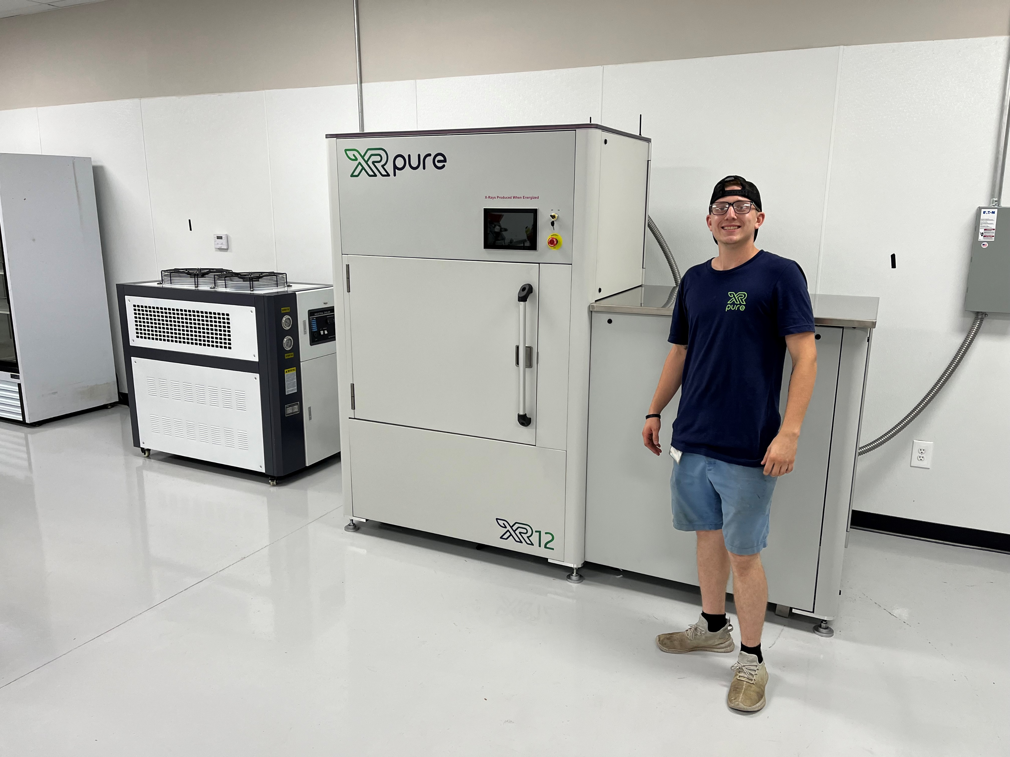
Decontamination service in Mississippi
Coastal Crop Cannabis in Lumberton
Contact Tommy Krumland (228) 218-3005

Slide 17
Jeff Adams
801-913-5067 jeff.adams@xrpure.com

