Slide 1

Carly Bader, MS
Manager of Science

Slide 2











Contaminant Testing: An Emerging Field of Cannabis
Categories of Cannabis Contaminant Testing
Pesticides
Heavy
Metals
Microbials
Foreign
Materials
Yeast
Mold
Bacteria
Aspergillus
Salmonella
E. Coli

Slide 3

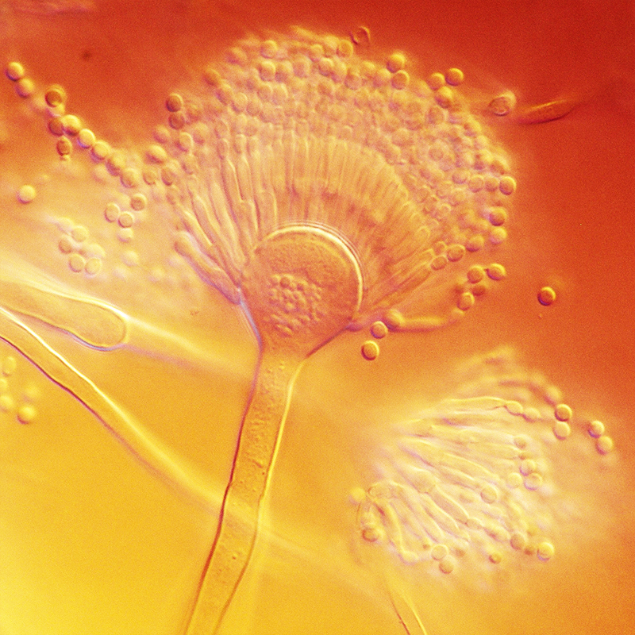
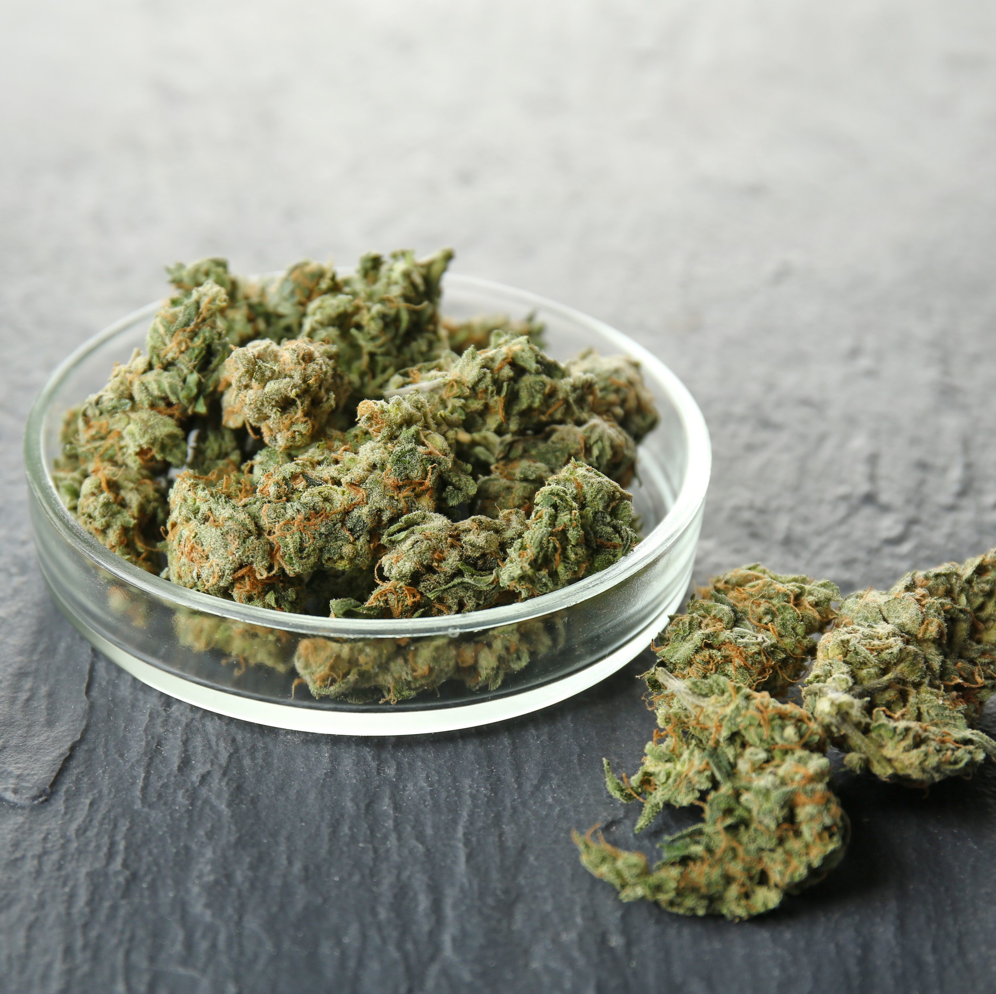
Is Cannabis Testing Necessary?
Beyond legal liability:
Consumers want products that are safe, high quality and consistent.
Medical Perspective
Consumer Safety Perspective
Aspergillus life-threatening for immune-compromised patients
Mold can grow while product sits on shelves, potentially causing allergic reactions in consumers

Slide 4
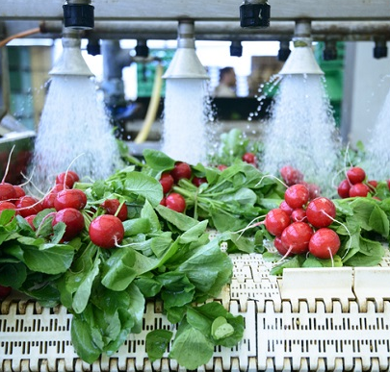
Decontamination Solutions
Decontamination is the point in the manufacturing process where harmful pathogens are eradicated from the product, and their growth is minimized over time.
Eliminate harmful bacteria & microbes
Meet standard quality regulations
Protect consumer safety
Prevent product recalls
Extend shelf-life
FDA’s Food Safety Modernization Act (FSMA) requires validation of all preventive controls, including the kill step.

Slide 5
How Does Ozone Decontamination Work?
Application of Ozone for Enhancing the Microbiological Safety and Quality of Foods: A Review
Journal of Food Protection, Vol. 62, No. 9, 1999, Pages 1071–1087
Jin-Gab Kim, Ahmed E. Yousef, and Sandhya Dave
Ozone (O₃) is a strong antimicrobial agent with numerous potential applications in the food industry.
Ozone has been used for decades in many countries and recently, the Generally Recognized as Safe (GRAS) status of ozone has been reaffirmed in the United States.
Ozone is effective against the majority of microorganisms tested by numerous research groups.
The molecule decomposes spontaneously to oxygen; thus, using ozone minimizes the accumulation of inorganic waste in the environment.
The high oxidizing power and spontaneous decomposition also makes ozone a viable disinfectant for ensuring the microbiological safety and quality of food products.
The reactivity of ozone is attributed to the great oxidizing power of these free radicals.

Slide 6
Ozone Efficacy
Review: The Use of Ozone Technology to Control Microorganism Growth, Enhance Food Safety and Extend Shelf Life:
A Promising Food Decontamination Technology
Wenya Xue, Joshua Macleod and James Blaxland, Feb 2023
Ozone is a promising alternative food preserving technique and has gained great interest in the food industry due to its auto-decomposition, rapid action, and strong oxidative properties to produce oxygen, and, most importantly, Ozone (O3; 48 g/mol) acts as a strong disinfectant due to the three oxygen atoms molecule. Ozone is formed by the addition of a free radical of oxygen to molecular oxygen.
Ozone can also inactivate microorganisms such as fungus [26] and yeasts [27]; pathogenic bacteria such as Escherichia coli, Salmonella typhimurium, and Listeria monocytogenes [28,29]; and viruses and protozoa [30]. The inactivation mechanisms of ozone against microorganisms have been previously discussed, including the ozone penetration of the cells, attacking cell membrane constituents, inactivation of the enzymes, and degradation of the genetic materials.
Depending on the application, ozone is generally employed at a range of concentrations either in its gaseous or aqueous form. As an example, gaseous ozone is produced continuously or periodically to process the harvested product and alter the storage atmosphere [20]. Aqueous ozone is generally applied instantly after the food harvest or during the food washing step [36,37]. In the washing process, the food products can be washed in ozone-dissolved water through different ways, such as: spraying, rinsing, or dipping [38–40]. In practice, the efficacy of both ozone phases in the inactivation of microorganisms can be affected by intrinsic and extrinsic factors as previously described.

Slide 7
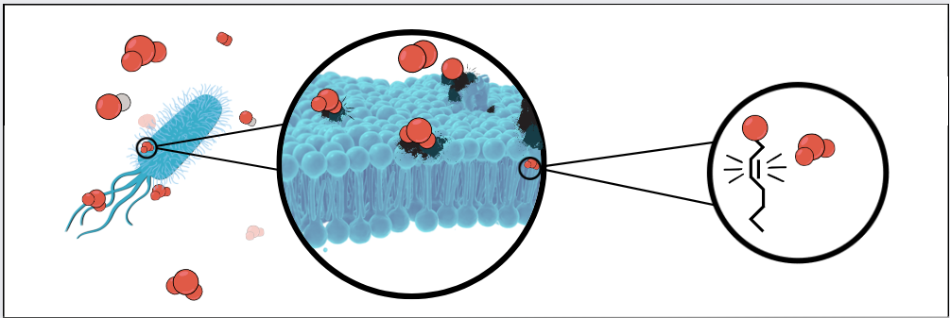
Ozone as a Marijuana Decontamination Strategy
Ozone treatment as a viable decontamination method is widely used in various settings, most notably as a tertiary treatment step in advanced municipal drinking water treatment plants all over North America.
Ozone, chemical formula O3 , is a molecule composed of three oxygen, which can easily be generated using an ozone generator.
This converts naturally occurring oxygen in the air into ozone, and when injected into an environment, will begin to immediately interact and oxidize molecules, including organic materials like the cell membranes of microorganisms. This oxidizing effect causes cell membrane disruption, inactivation of the enzymes, and degradation of the genetic materials, which leads to lysis and cell death, the mode of action behind microbial remediation using ozone as a treatment method.

Slide 8
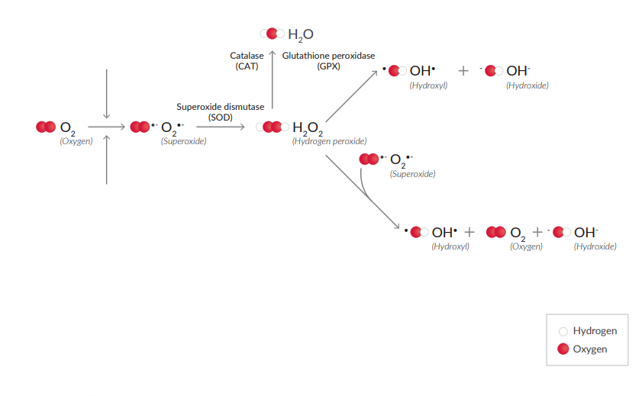
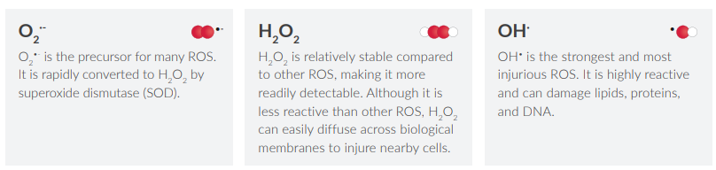
O3 ozone
https://cdn2.caymanchem.com/cdn/cms/caymanchem/LiteratureCMS/Oxidative%20Stress.pdf

Slide 9
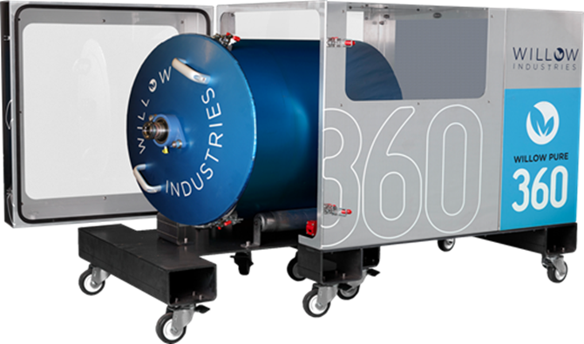
Proprietary Technology – WillowPure360

Slide 10
Occupational Safety
OSHA regulates employee exposure to ozone gas through its Air Contaminants Standard, 29 CFR 1910.1000. The permissible exposure limit (PEL) is listed as an 8-hour, time-weighted average value of 0.1 part of ozone per million parts of air (ppm). Rule 29 CFR 1910.1000(e) requires that administrative or engineering controls must first be identified and implemented whenever feasible to achieve compliance with the PEL.
Our process takes place in a drum, which provides primary containment for the ozone gas. A sustained concentration of ozone is created and circulated through the system and is converted back into diatomic oxygen through a catalytic "destruct unit" before being released to ambient air.
The enclosure which surrounds the drum creates secondary containment by using fans to induce a draft back into the 360 cabinet, this would control leaks from malfunction drums and lids.
Within the 360 cabinet there is a leak detector which triggers after being at 0.1 PPM for five minutes. In the event the leak detector is triggered, ozone is shut off and the machine begins to displace all ozone into the destruct unit. Willow and the operator are notified every time there is a leak detected. This leak detector would also indicate the failure of the destruct unit.
The cooling fans on the 360 cabinet are also equipped with a catalyst, which is the final means of mitigating any of the minor leaks which would be detected by the ozone detector.

Slide 11
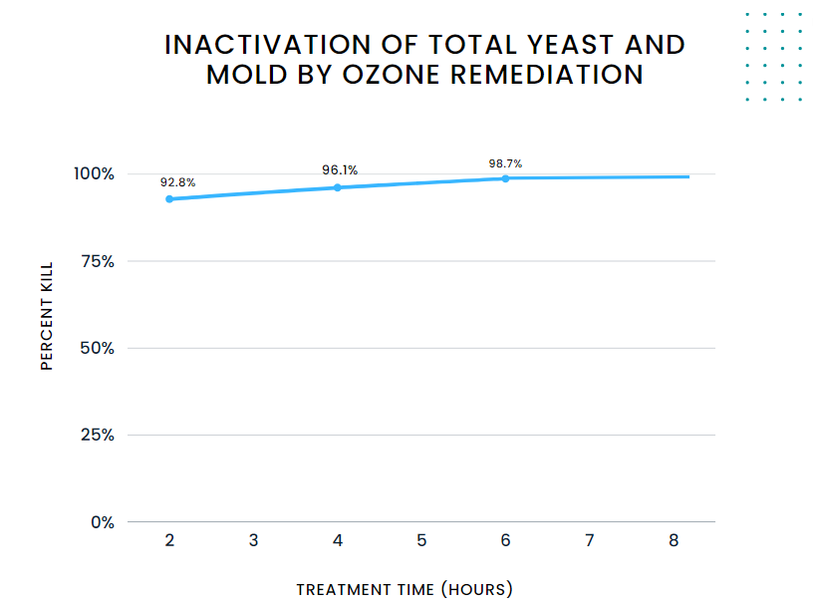
Internal Data - Percent Kill
Building a more robust data set from 20 independent cultivators and 184 raw data points, the following graph shows that generally, on average,
a 2-hour run results in approximately a 92% kill,
a 4-hour run results in just under approximately a 94% kill and a 6-hour run approaches approximately a 98% kill.

Slide 12
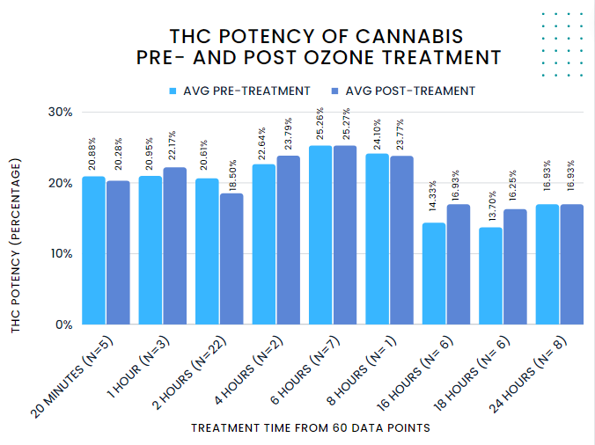
Internal Data - THC

Slide 13
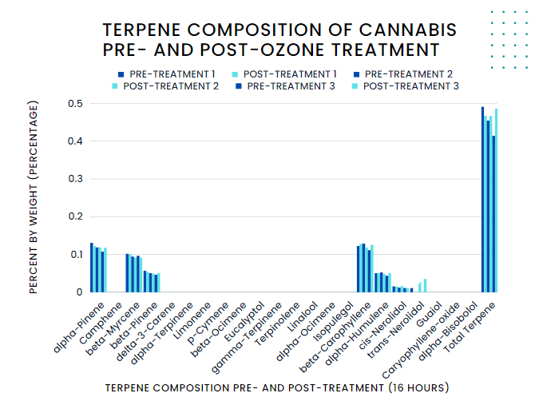
Internal Data - Terpenes

Slide 14
Anonymized cultivator testing results show consistent percent kill of 99+% for Total Yeast and Mold (TYM) when following GMP (Good Manufacturing Practice) sanitation program.
Willow Scientific microbial partnership program, which applies agricultural best practices and microbial insights, are also contributing factors to successful and consistent high microbial kill using our proprietary method.

Slide 15
As the emerging culture surrounding cannabis becomes increasingly centered around quality products, it is important that the growing industry understands the various new trademarks and technologies available to their total quality management processes.
Understanding quality assurance infrastructure and checkpoints necessary within manufacturing and agricultural practices aids to reduce microbial bioburden to produce safe, high-quality products.

Slide 16
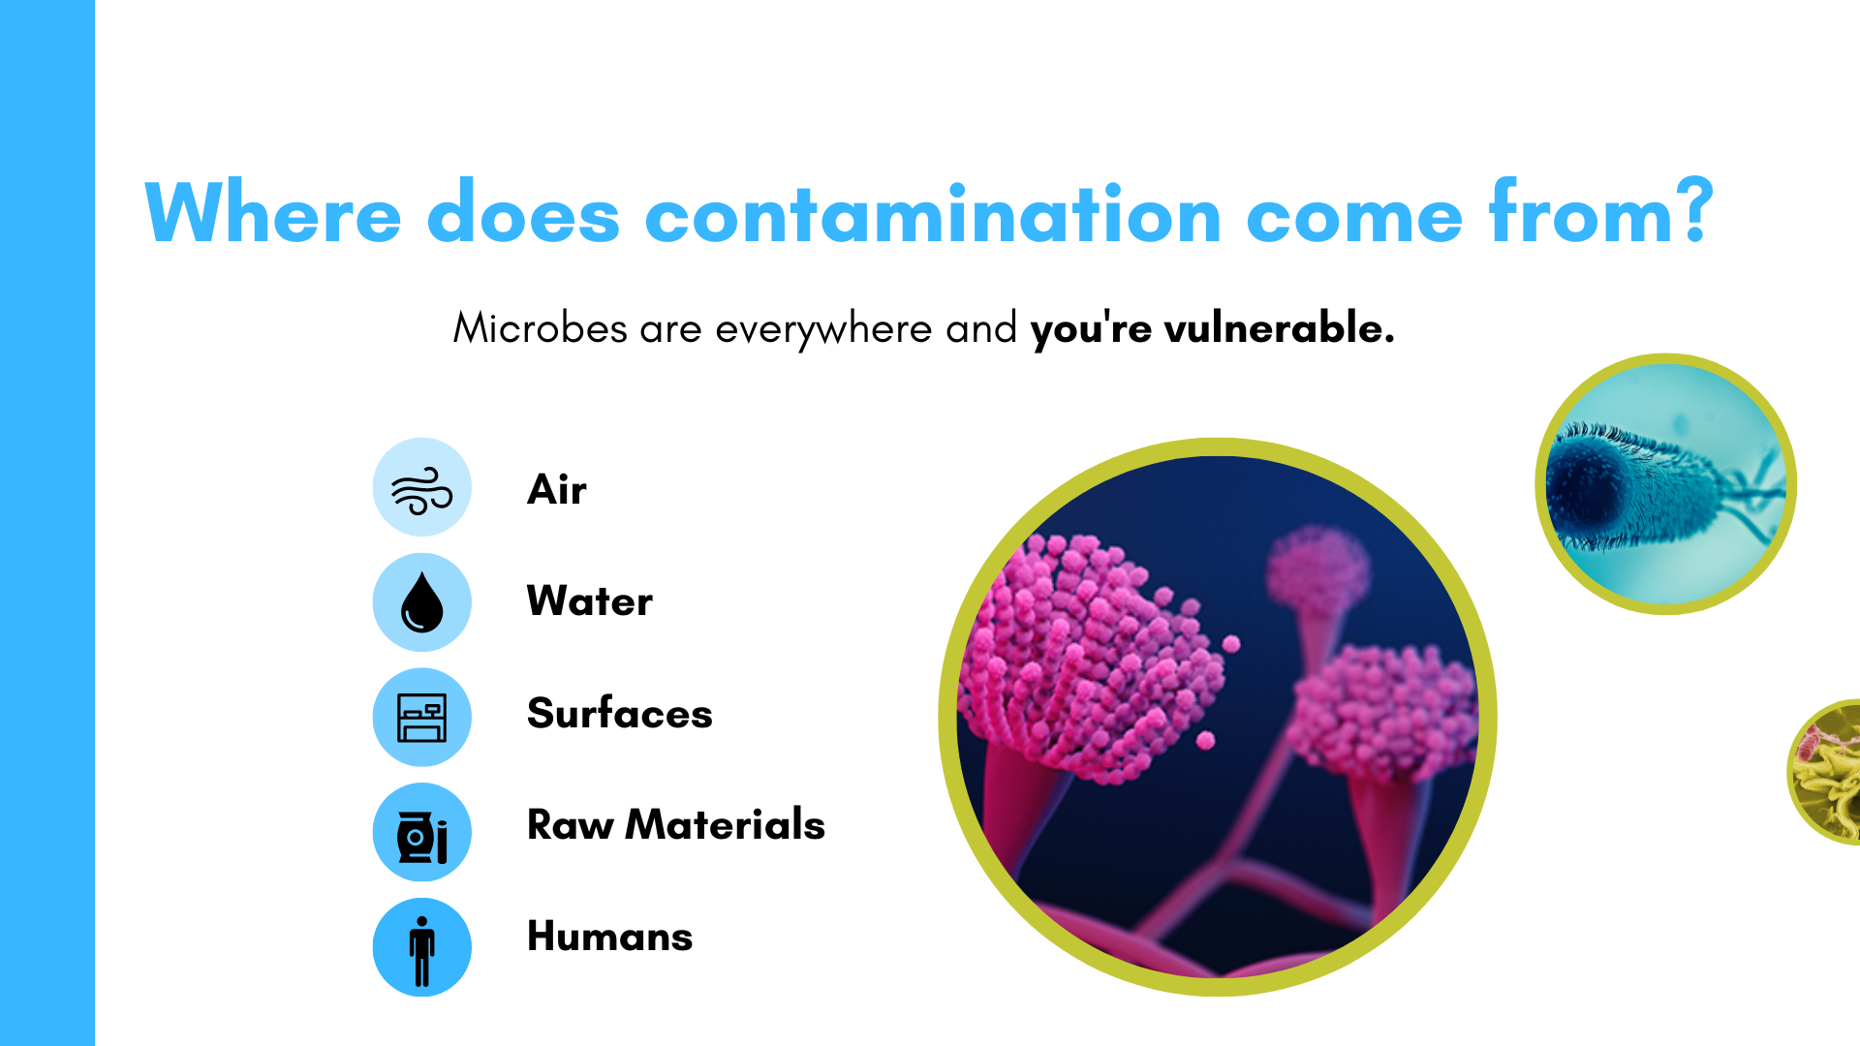
The Source

Slide 17
The unique methods of exploration and testing executed by Willow Scientific in tandem with education around reducing the bioburden both up and downstream, specific to yeast, mold, aerobic and coliform bacteria, as an inclusive group of indicator organisms, can be the tool needed to increase both speed and scale towards greater sales. By providing teams with greater understanding comes greater control and the common goal of improving product quality.

Slide 18
Improving processes and simplifying documentation
Understanding quality assurance infrastructure and checkpoints necessary within manufacturing and agricultural practices to reduce microbial bioburden to produce safe, high-quality products.
We take great care in understanding your current Standard Operating Procedures and processes while providing recommendations based on your data.
Our Microbial Assessments and Toolkit provide you with detailed data around the contaminants that are most important to your team.
Testing inputs and outputs can help determine causation!

Slide 19
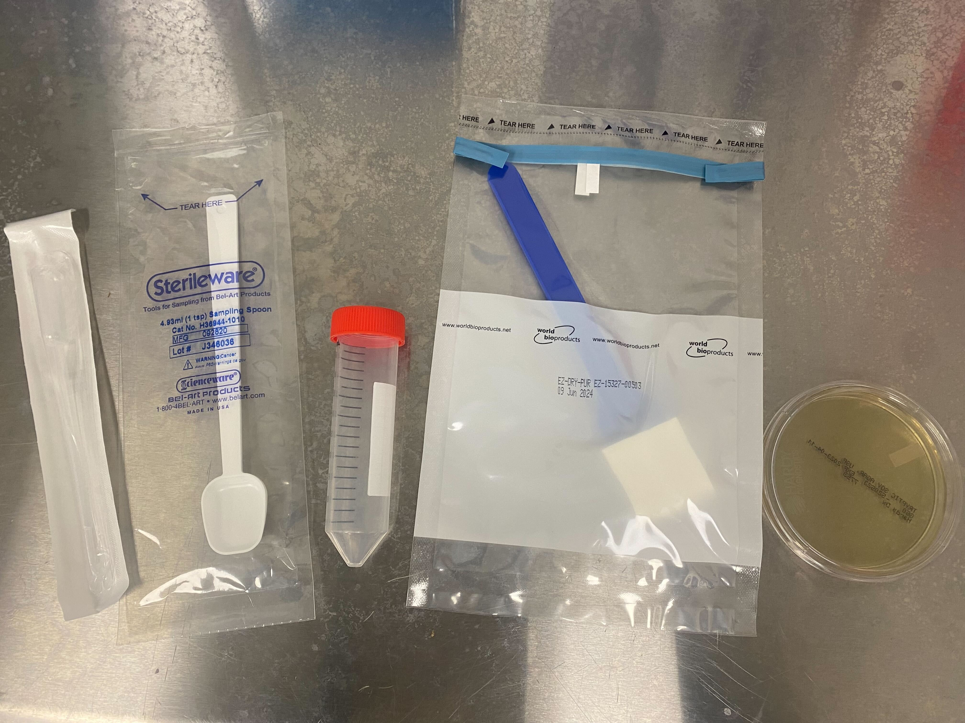
Scoop for solid sample collection
Bulb pipette for liquid
sample collection
Swabs for surface sampling
Collection tube for liquids and solids
Air collection sampling plates

Slide 20
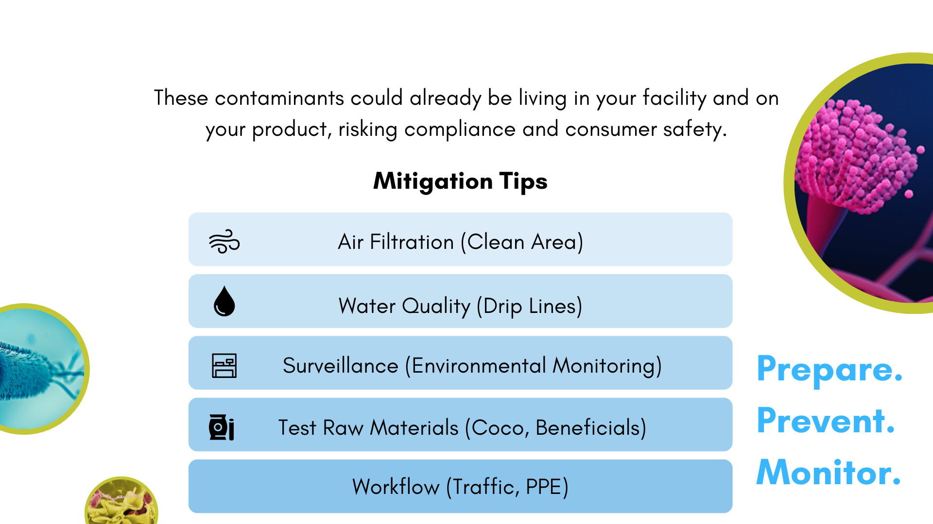

Slide 21
Employing these strategic and systematic approaches along with a clearly outlined and easily adhered to procedures within a documented workflow we can additionally provide the cannabis industry with endless insight to the various approaches to producing quality cannabis. This data can be utilized to increase efficacy and efficiency, while also minimizing waste and lowering company-wide costs. Continuous improvements such as the ones provided by Willow Industries can encourage the long-term success of this shifting business culture.

Slide 22

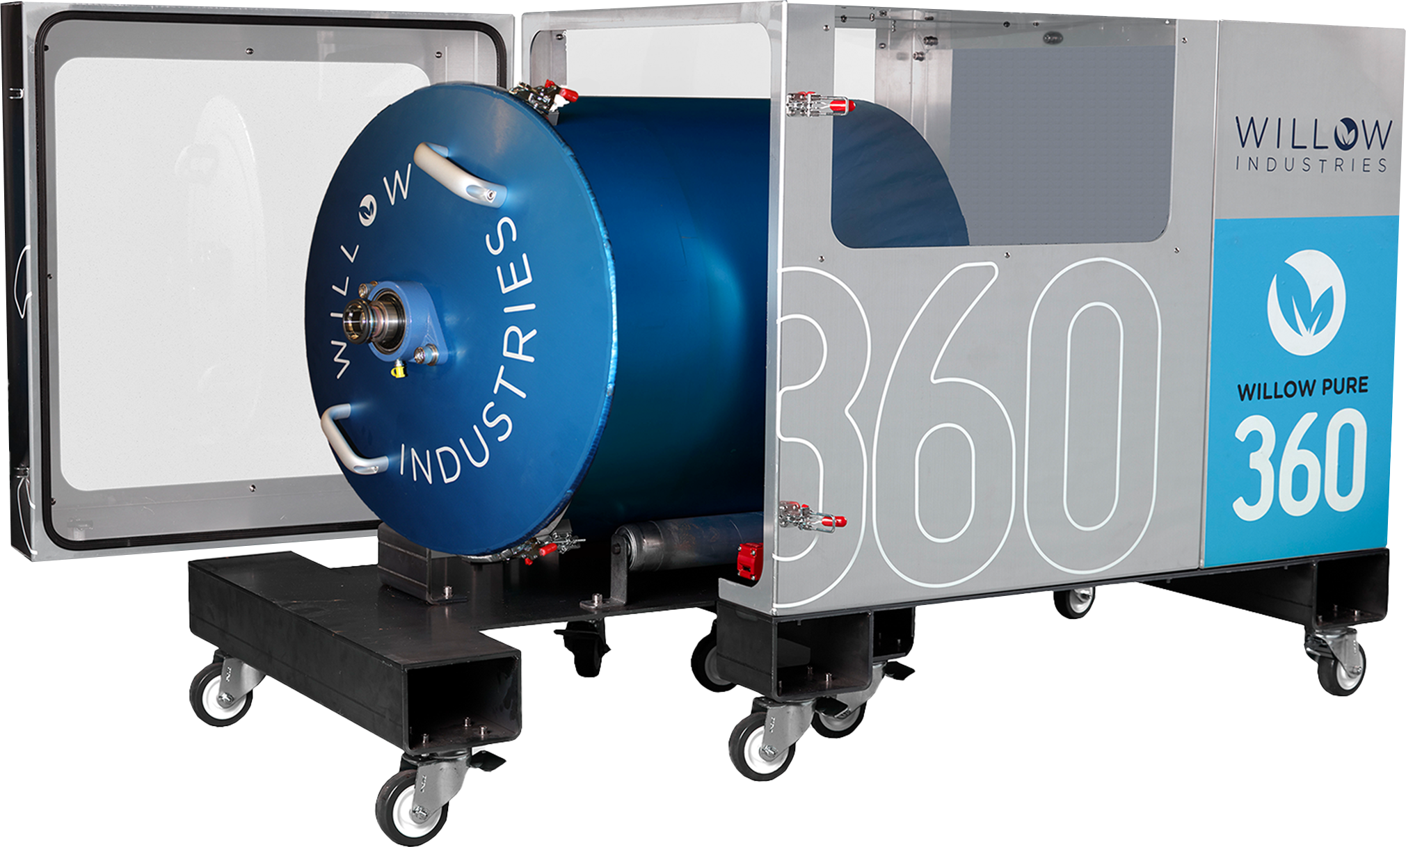
Clean Cannabis Technology
Let’s Keep the Conversation Going!
NL
BC
AB
SK
QC
ON
ME
WA
VT
MA
MT
ND
MN
NY
NH
OR
ID
WI
RI
WY
SD
MI
PA
NJ
CT
NE
IA
IN
OH
DE
IL
WV
VA
MD
CA
NV
UT
CO
KY
Washington D.C.
KS
MO
NC
OK
AR
TN
SC
AZ
NM
MS
AL
GA
HI
TX
LA
FL
www.willowindustries.com

